Slide 1
Wine Recommender System
Pitch Presentation
By: Shane Nelson, Allie Schneider, Francis Villamater, Will Wu
Notes:
Francis

Slide 2
Goals
To create a system to allow users to discover more wine
System should be applicable to a wide range of users
From novice wine consumers to well-versed wine sommeliers
Recommendations should be relevant and applicable to the user
System should:
Provide accurate objective wine recommendations based on flavor profile, vintage, winery, etc.
Effectively estimate the ratings of new wines added to the database, but also take into account the user’s own wine review scores to account for personal preferences
Notes:
Francis

Slide 3


Dataset Resources and Acquisition
Kaggle.com
Wine Reviews dataset
The dataset was scraped from WineEnthusiast on June 15, 2017
Obtained through kaggle
Notes:
Francis

Slide 4
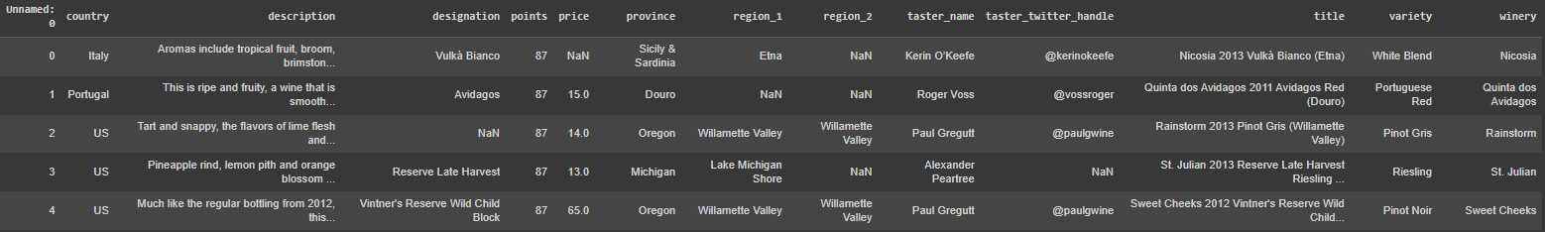
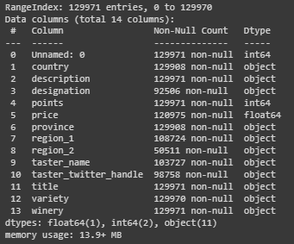
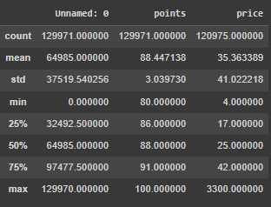
Dataset Snapshots
Notes:
Francis

Slide 5
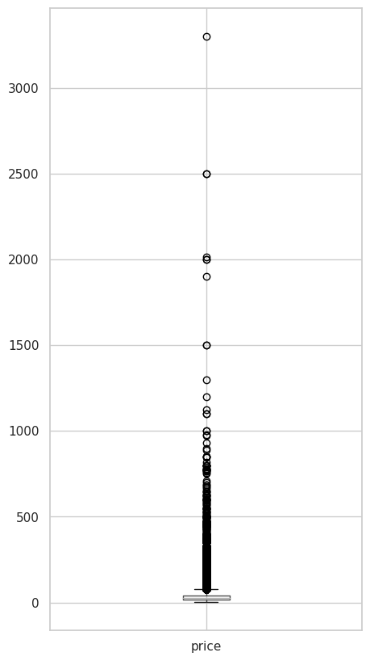
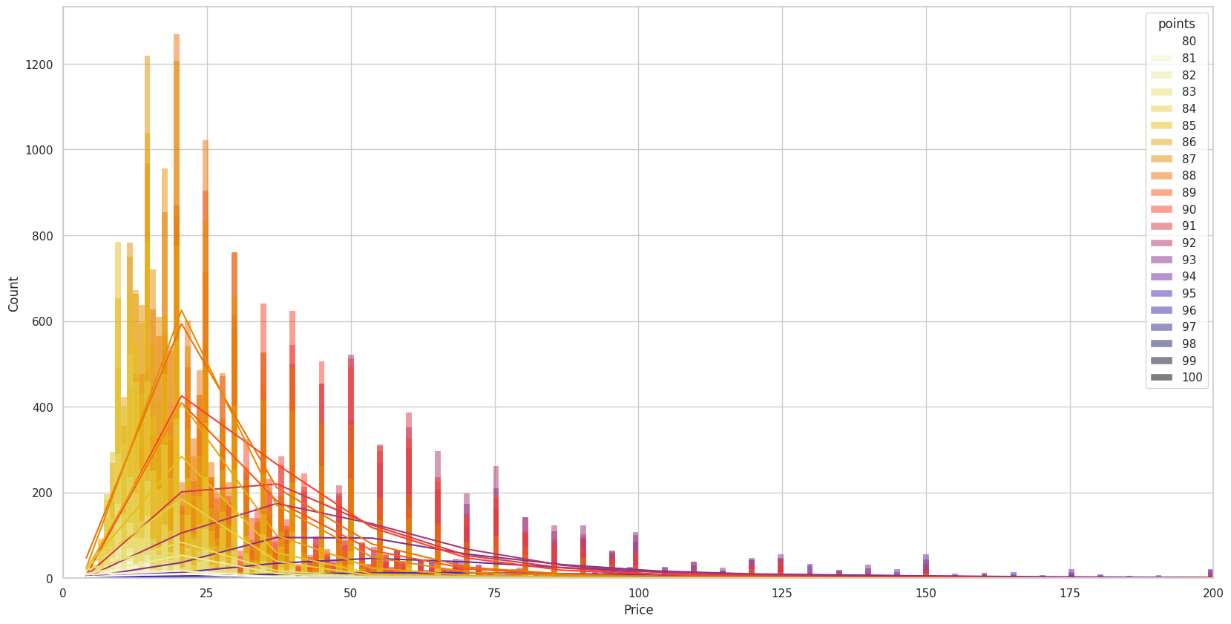
Initial Observations - Price
Wine price has a heavy right skew (Mean: $35.36, Median: $25, Range: $4-$3300)
Notes:
Allie

Slide 6
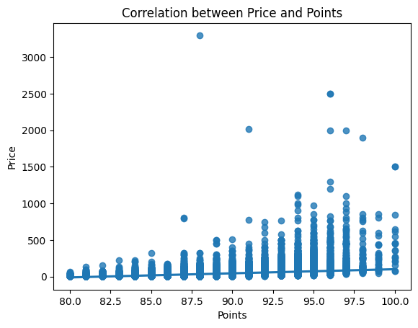
Initial Observations - Price
Pearson Correlation = 0.42
Notes:
Allie

Slide 7
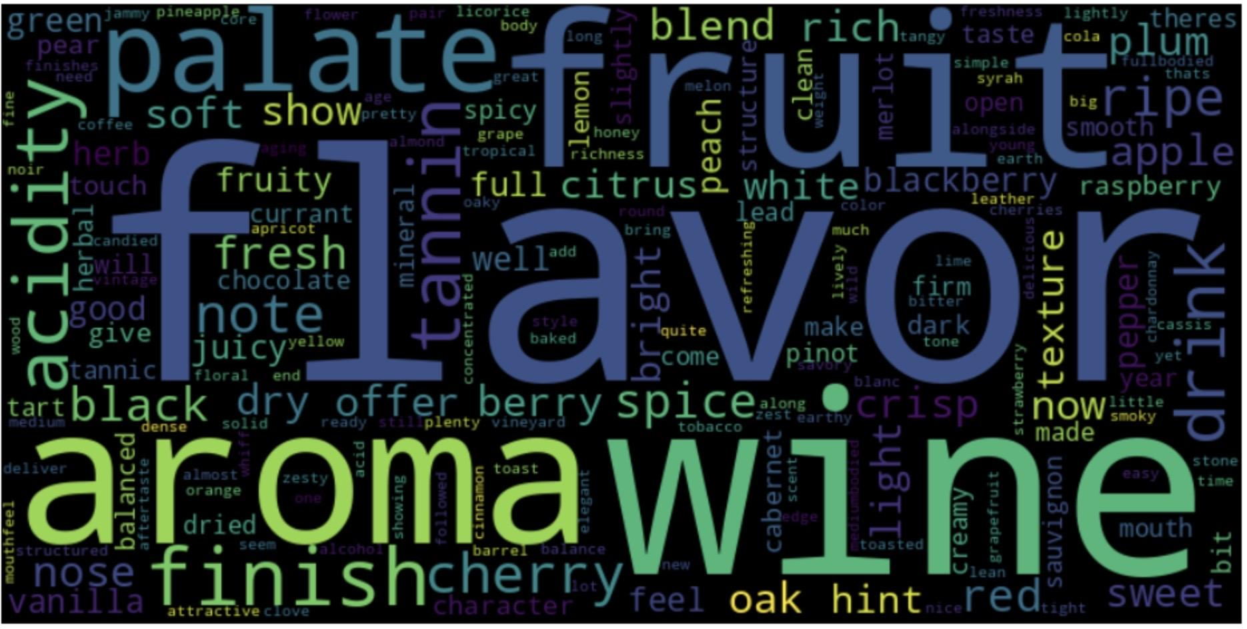
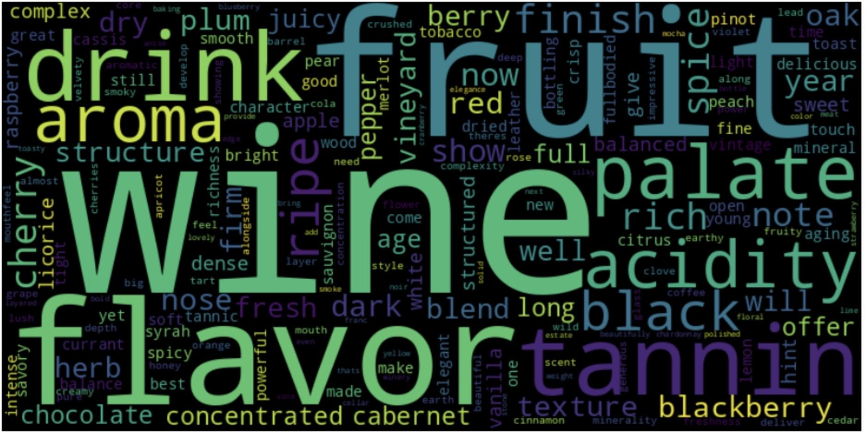
Initial Observations - Descriptions
Low Point Wines (Rating < 90):
High Point Wines (Rating >= 90):
Notes:
Allie
Shane to add low_point word cloud

Slide 8
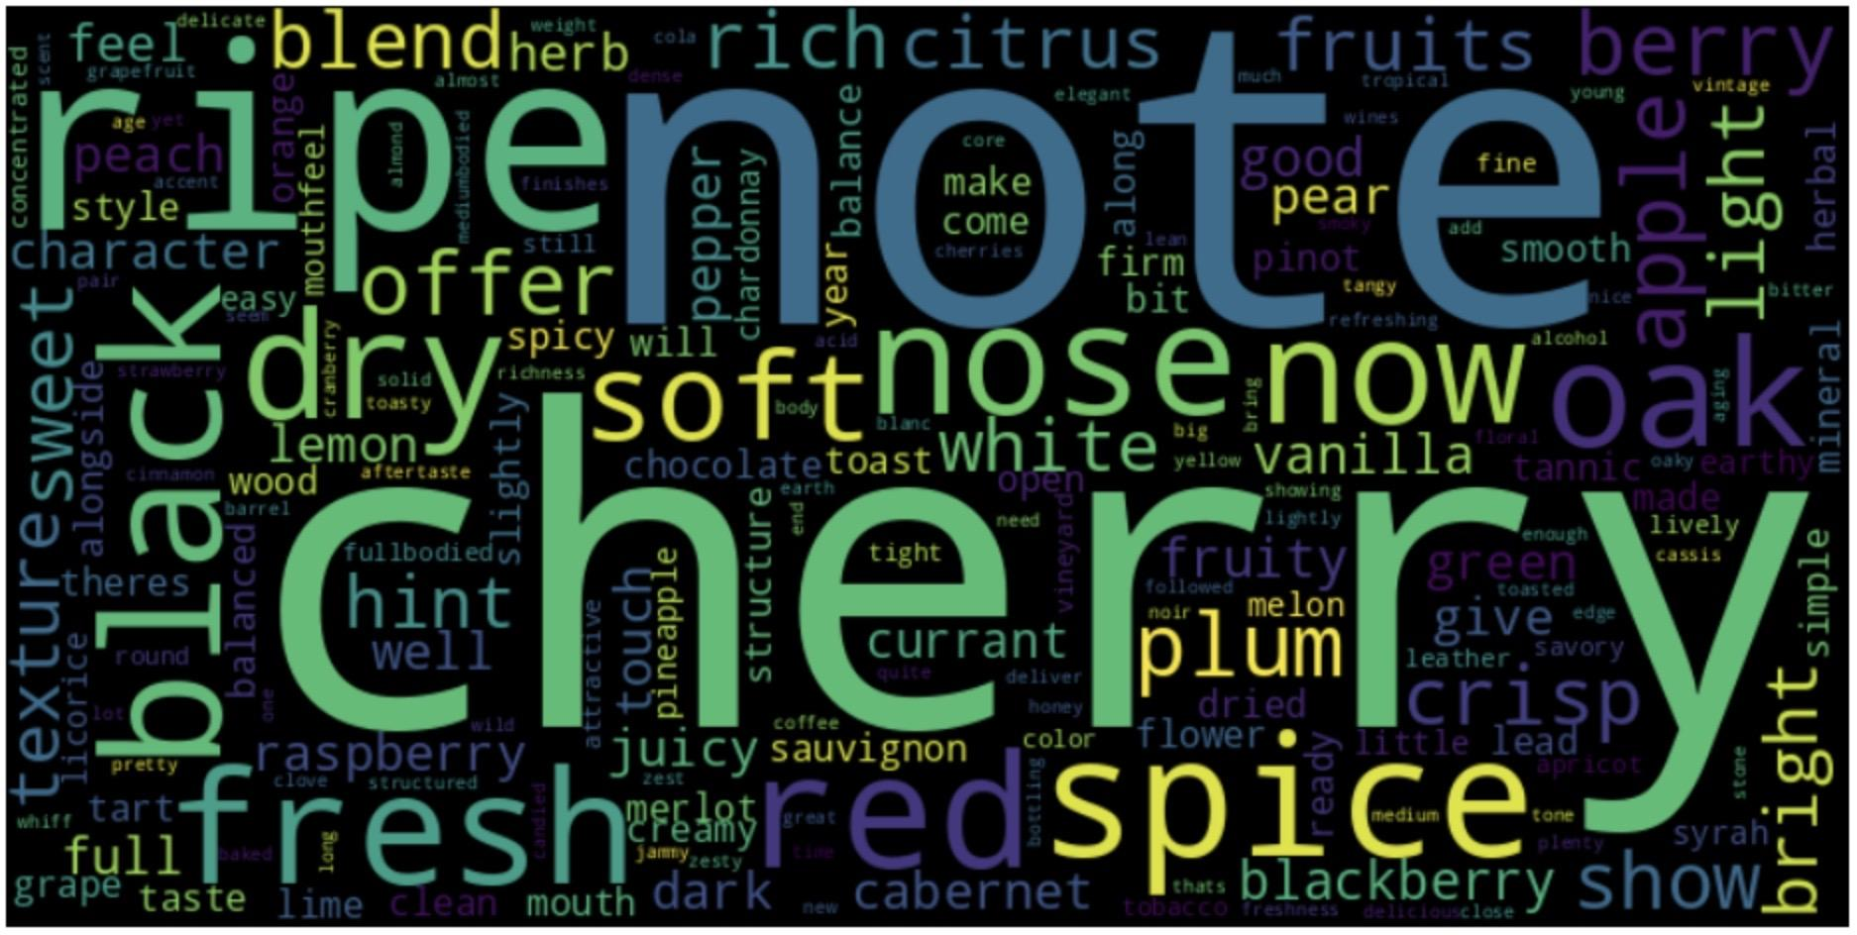
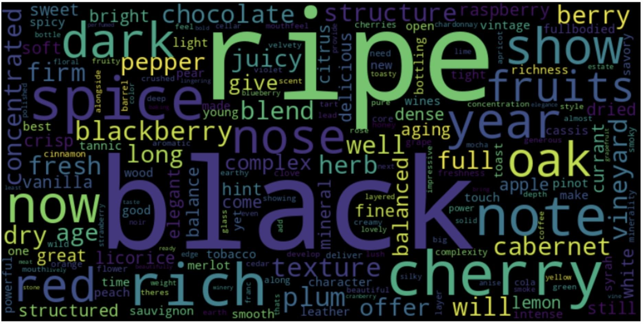
Initial Observations - Descriptions
Low Point Wines
After Removal of Common Words
High Point Wines
After Removal of Common Words
Notes:
Allie
After removal of: wine, flavor, fruit, aroma, tannin, palate, acidity, flavors, aromas, tannins, drink, finish

Slide 9
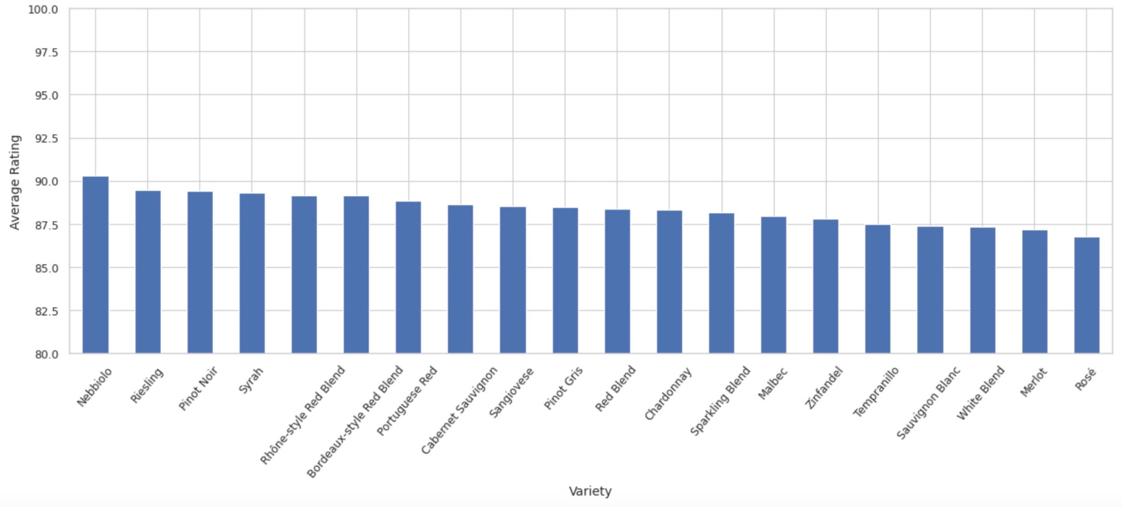
Initial Observations - Variety
707 unique varieties (421 occurring less than 10 times in the entire dataset)
Average Rating of Top 20 Most Common Varieties
Notes:
Shane

Slide 10
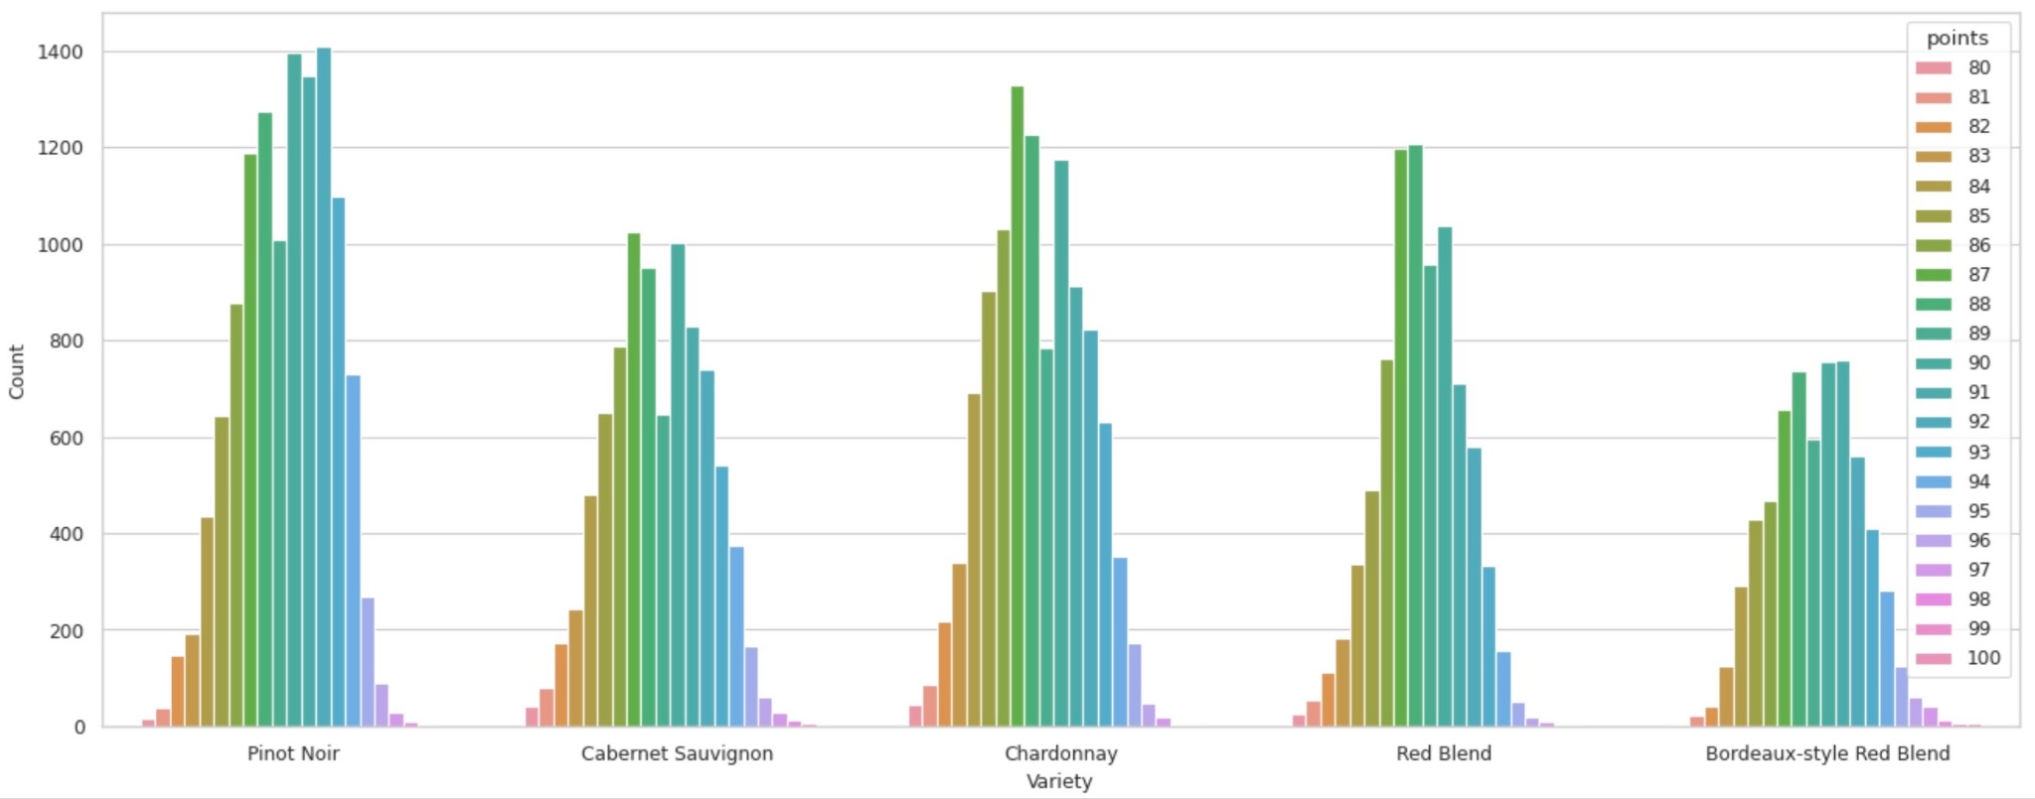
Initial Observations - Variety
Rating Distribution of 5 Most Common Varieties
Notes:
Shane

Slide 11
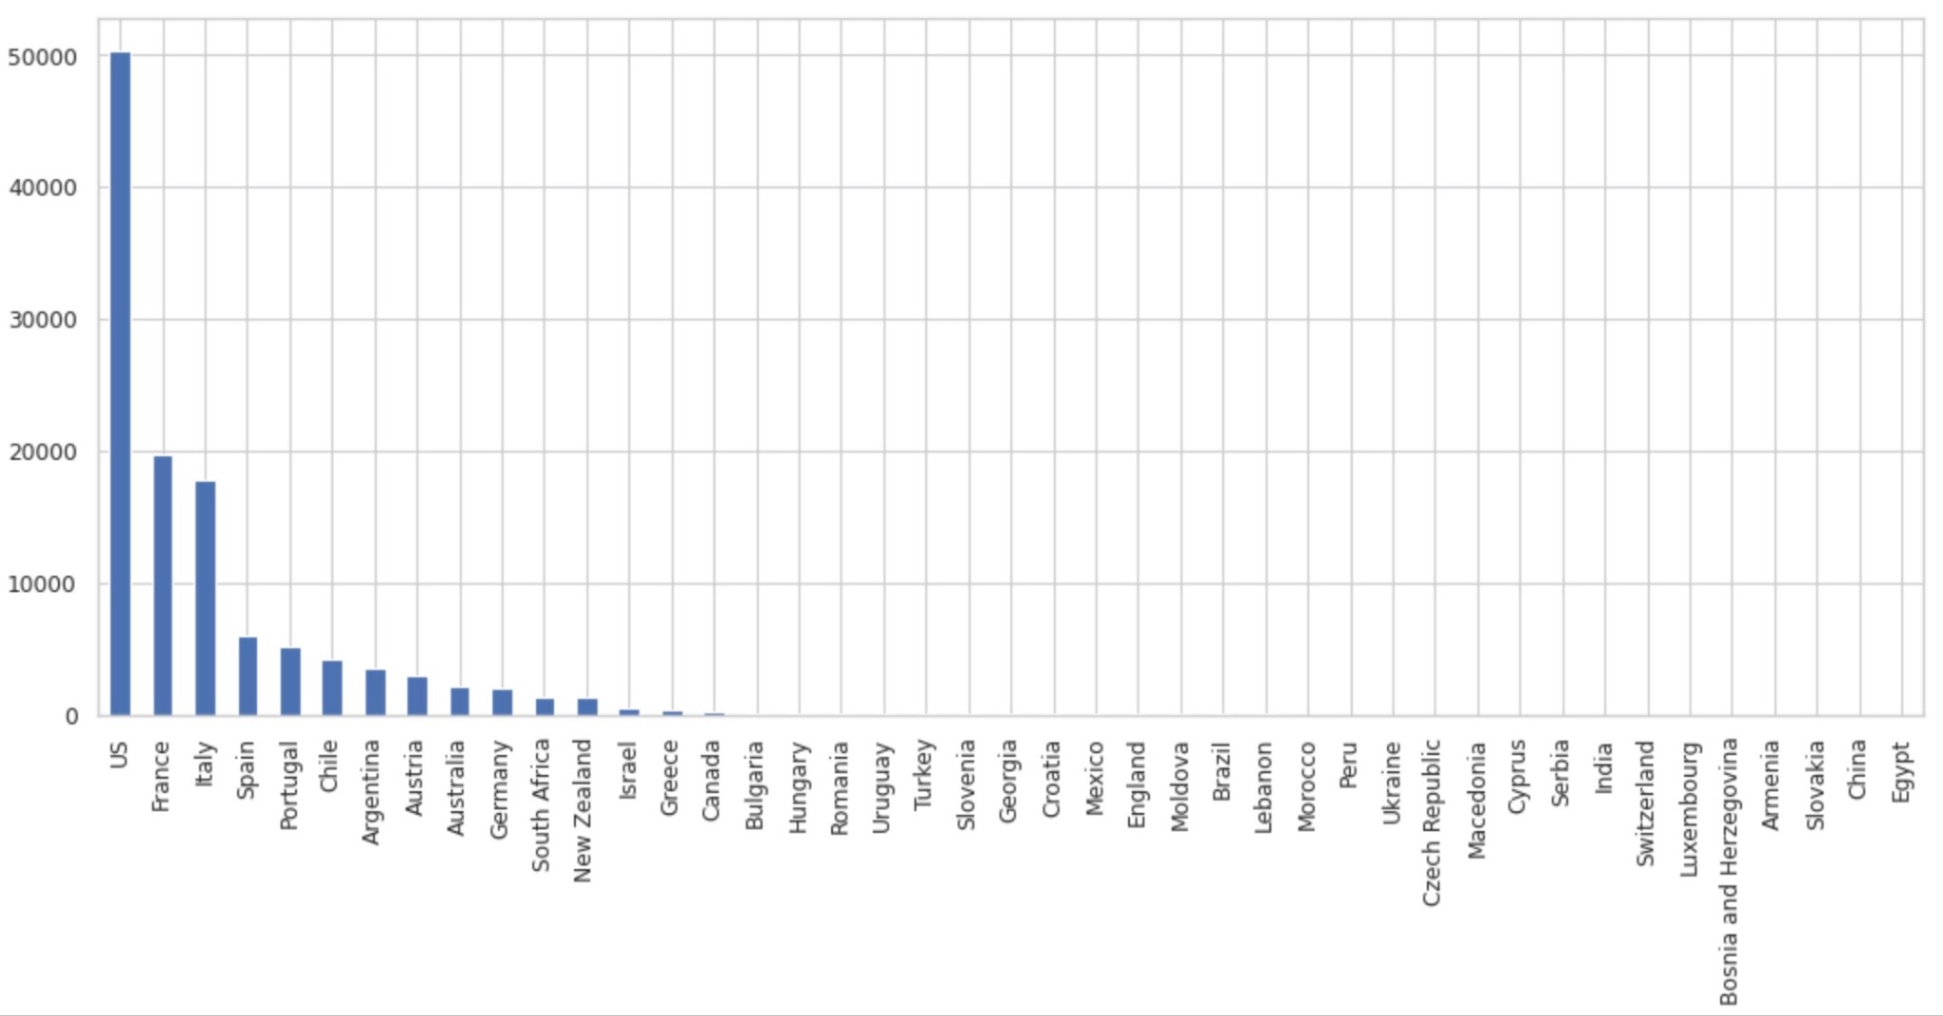
Initial Observations - Country
43 unique countries
Distribution of Wines by Country
Notes:
Shane

Slide 12
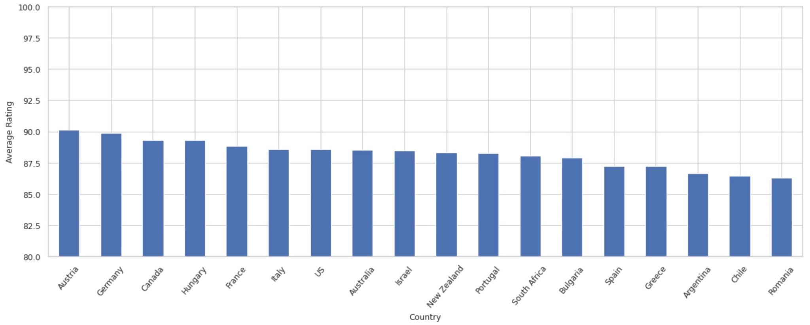
Initial Observations - Country
Average Rating for Countries with >100 Reviews
Notes:
Shane

Slide 13
Next Steps
Determine any additional attributes to be used for our recommender system (region, province, designation, and winery are all questionable)
Analyze free-text field of “descriptions” for keywords that are associated with different scores or wines
Thoroughly explore the free-text field “description”
Potentially plenty of keywords that can be used to classify wine varieties
Determine how to best handle “null” and missing values
Determine how to best handle outliers or rare occurrences of attributes
Notes:
Will

Slide 14
Thank You
Github Repository: https://github.com/snelson97/DSCI591_G8SAFW
Notes:
Will

